Slide 1

The purpose of this assignment is to make you familiar with following topics:
• Tree
• Binary Tree
• Terminologies of a Binary Tree
• Level
• Complete Binary Tree
• Level of a Complete Binary Tree

Slide 2
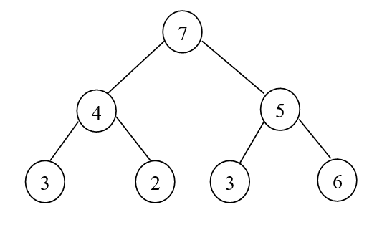
Write down C++ code to create a complete binary Tree in which user can add any number of node/elements (Numeric).
After Creating a complete binary tree , You need to calculate the product of the 2nd lowest level and find the smallest number in the binary tree as given in the example:
Product of Elements in 2nd last level (N-1)= 20
Smallest number in Binary Tree = 2

